Slide 1
Hexa Opal
Aryan Shahbaz
Mahdi Khademi
Mohammad Saleh Tavakoli
Amirali Saghlatoon nia
Pouyan Rais Esmaili
Mohammad Yasin Sharafie

Slide 2
Our Tactics
Pass
System
Dynamic
Formation
Offiside
Trap

Slide 3
Pass System
Passing System in Penalty
area
Pass in
Game

Slide 4
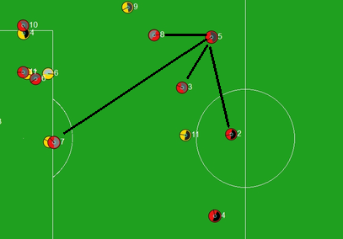
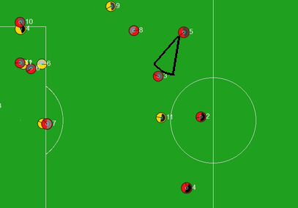
Passing System in game
Notes:
We create a system for our pass function. We try to decrease wrong pass rate and increase complete pass rate.
Our system works according to these following steps:
Find the nearest teammate and their distance to player that have the ball.
Check no opponent near to our target player.
Make a Sector2D to target player.
Kick the ball using Smartkick() function.
In figure left, there is one of our player (player 5) that wants to make a pass and shows the nearest players and in figure right, our player make a Sector2D to get ready to kick the ball using Smartkick().

Slide 5
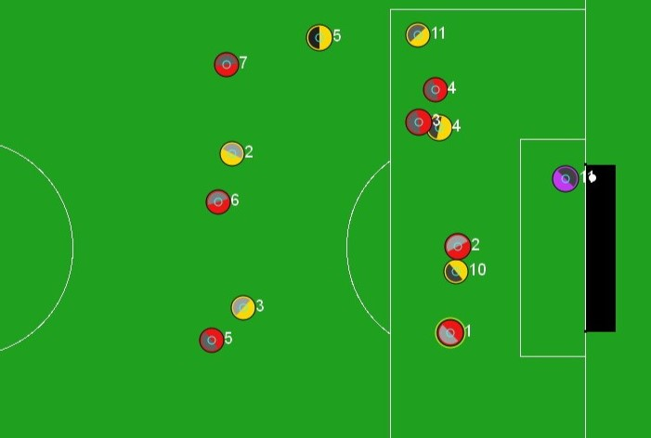
Passing System in penalty area
Notes:
Penalty area is one of the important areas in SS2D because players are near to each other and they can get the ball from opponent easily so we need a system to help us to decrease wrong passes rate in penalty area to keep ball with our players and create a good position to shoot to ball and get a goal.
Our system checks the players of both of the teams that they are in opponent’s penalty area. If our player makes pass more than 5 times, the last player get the ball have to pass the ball to nearest player out of penalty area. Otherwise, if our player makes pass less than 5 times, the player has a better chance to make goal and shoot have to shoot the ball and make a goal for our team.
In figure left and right we can see the both situations of passing in penalty area. In figure left, player 3 have no choice to pass to player in penalty area and it has to pass to player 6 or player 7 that they are out of penalty area. In figure right, player 1 have a better chance to shoot and shoot and get a goal for our team.

Slide 6
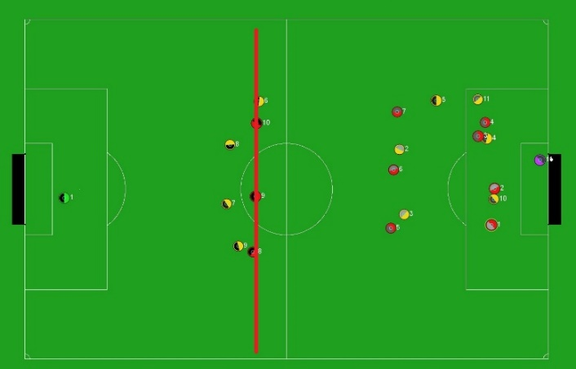
Offside Trap
Notes:
When the home team is in possession of the ball, we record the position of the rearmost opponent's player (except the goalkeeper) with programming commands and obtain the longitudinal position of the players and consider it as the offside line, then two to three players of our team depending on The conditions of the game are placed exactly on the offside line, and for the player who owns the ball, depending on the position and freedom of action, a player on the offside line is assumed to be the target player. Then, the empty space of the opponent's defenders is supposed to be scanned by the target attacker, and the pass of the player who owns the ball is exactly in the same space, and the target player moves towards the empty space with maximum energy after sending the pass. In figure 7 we show an offside trap and shows the offside line.

Slide 7
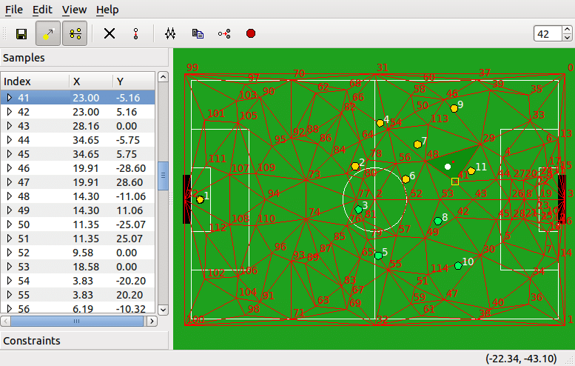
Dynamic Formation
Notes:
With the help of fedit2 software, we were able to create our team’s formations. Fedit2 is a program to create formation for SS2D that developed for Ubuntu by Helios team. We created our formations with fedit2. We developed a script with C++ programming language that can change the formations to compile able script for server of the match and used them in our team source code. Figure 2 shows environment of fedit2 application.

Slide 8
Thanks for your attention

